Slide 1
Project Proposal
Sport Statistics – Olympic Data
September 2020
Antonio Torralba

Slide 2

Index
Data Selection
Questions and Approach
EDR-Diagram
Data Preparation
Data Analysis
Discovery
Recommendations

Slide 3
Data Selection
Sports Stats (Olympics – 120 years of data)
Objectives
Identify relations between nacionality, sex and sport.
Calculate the weights of each attribute involve in getting a medal.
Identify most relevant attributes for each sport.
Differences between medalists and non-medalists.
Potencial Audience
Couches, Betting companies, General Managers...

Slide 4

Questions and Approach
Questions
Which are the most popular sports?
Does some contries are inherently better at some sports?
Are height and weight equally important on each sport?
Are medalists and non-medalists actually so different?
Approach
Calculate the number of participants in each sport (Every team counts as one)
Group medalists by nationality.
Calculate height and weight for each sport.

Slide 5
ERD-Diagram
ERD-Diagram proposal
Athelete
Id
Name
Sex
Age
Height
Weight
Id_Team
Id_Game
Id_Event
Id_Medal
Game
Id
Games
Year
Season
City
Team
Id
team
NOC
Event
Id
Sport
Event
Medal
Id
Medal

Slide 6


Data Preparation
Import the data
Select the data
Upload Files
Attach to a cluster table
Create the ERD tables
Data Bank

Slide 7
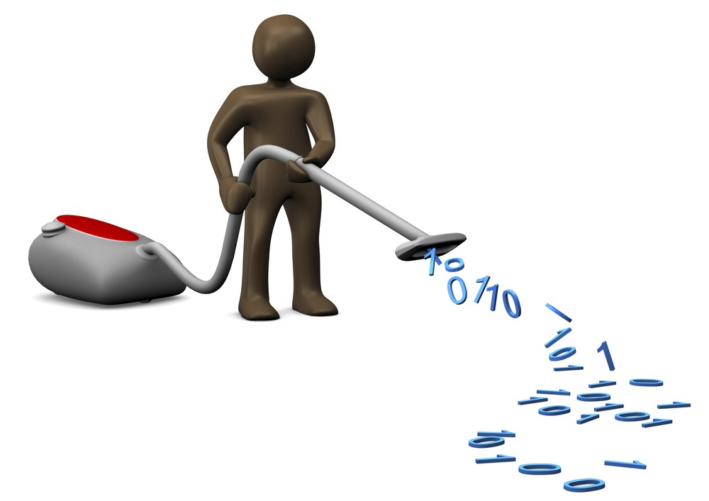
Data Preparation
Clean the data
Check for inconsistencies
Eliminate duplicate data
Delete incomplete data
Drop non correlated columns

Slide 8
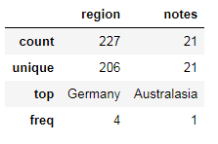
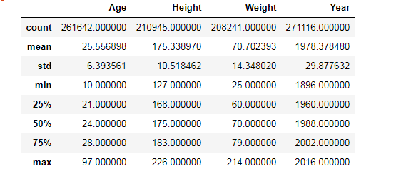
Data Preparation
Initial Exploration
Size of the data
Number of sports
Type of the data
Basic statistics

Slide 9
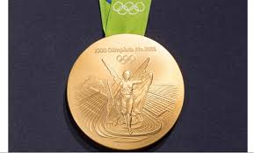
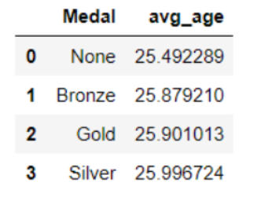
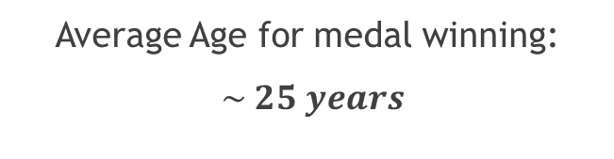
Data Analysis
Average Age for medal winning:
$\sim 25 years$

Slide 10
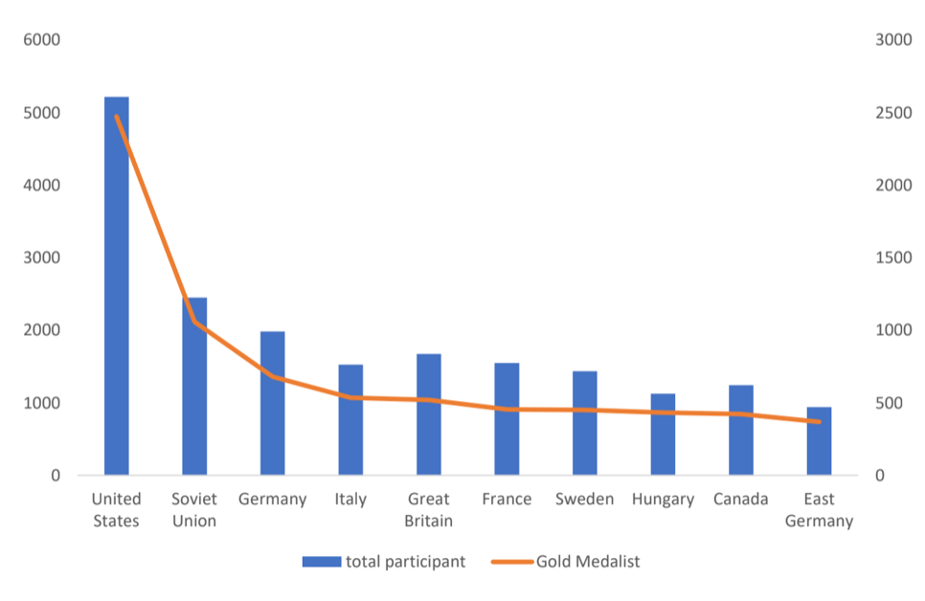
Data Analysis
Linear correlation between the number of participants per country and the number of medals won by those countries.

Slide 11
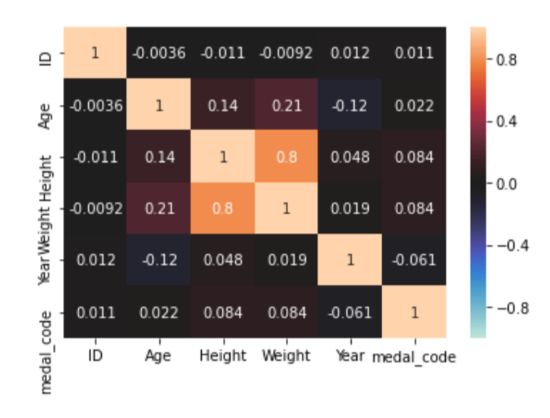
Data Analysis
There is a weak correlation between the Weight/Height ratio with the medals:
Correlation value of 0.082

Slide 12
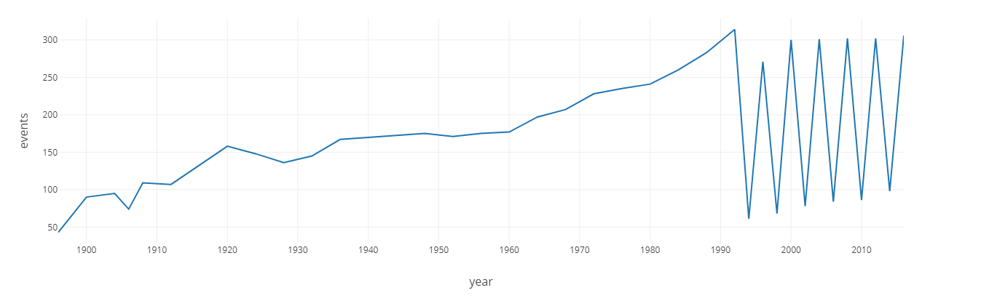
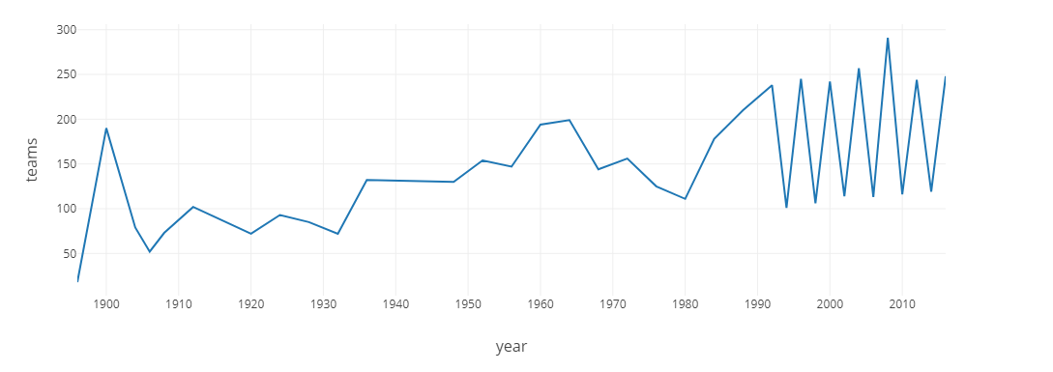
Discovery
Over this period of time, the number of teams and athletes grew with a strong impact in the year of 1924. It could explain why the number of events increase in 1928.

Slide 13
Recommendations
Recommendations
Based on the analysis or insights we discovered we are able to support the countries in order to help them grow in the sports arena
We can encourage people into contributing to participate in sports to represent their countries growing their economy
We recommend that the productivity and rates obtained in this work could be at people´s disposal

